Slide 1
Unit II
Process Management

Slide 2
Process concept:
The process concept includes the following: 1. Process
2. Process state
3. Process Control Block
4. Threads
Process: A process can be thought of as a program in execution (or) A process is the unit of work in a modern time-sharing system. A process will need certain resources such as CPU time, memory, files and I/O devices to accomplish its task. These resources are allocated to the process either when it is created or while it is executing. The below figure shows the structure of process in memory

Slide 3
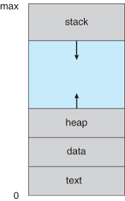
Structure process in memory:

Slide 4
The process contains several sections:
Text, Data, Heap and Stack.
• Text Section contains the program code. It also includes the current activity, as represented by the value of the program counter and the contents of the processor’s registers.
• Process stack contains temporary data such as function parameters, return addresses and local variables.
• Data section contains global variables.
• Heap is memory that is dynamically allocated during process run time.

Slide 5
Difference between Program and Process:
• A program is a passive entity, such as a file containing a list of instructions stored on disk often called an executable file.
• A process is an active entity with a program counter specifying the next instruction to execute and a set of associated resources.
• A program becomes a process when an executable file is loaded into memory.

Slide 6

Process State diagram:

Slide 7
Process State As a process executes, it changes state. The process state defines the current activity of that process.
A process may be in one of the following states:
• New: The process is being created.
• Ready: The process is waiting to be assigned to a processor.
• Running: Instructions are being executed.
• Waiting: The process is waiting for some event to occur such as an I/O completion or reception of a signal.
• Terminated: The process has finished execution.

Slide 8
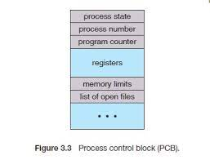
Process control block
Each process is represented in the operating system by a Process Control Block (PCB). It is also called a Task Control Block. PCB serves as the repository for any information that may vary from process to process

Slide 9
The PCB contains information related to process such as:
• Process state: The state may be new, ready, running, waiting and terminated.
• Program counter: The counter indicates the address of the next instruction to be executed for this process.
• CPU registers: The registers vary in number and type, depending on the computer architecture. They include accumulators, index registers, stack pointers and general-purpose registers etc. Along with the program counter, this state information must be saved when an interrupt occurs, to allow the process to be continued correctly afterward
CPU-scheduling information: This information includes a process priority, pointers to scheduling queues and any other scheduling parameters.
• Memory-management information: This information includes the base and limit registers values, the page tables or the segment tables depending on the memory system used by the operating system.
• Accounting information: This information includes the amount of CPU and real time used, time limits, account numbers, job or process numbers and so on. • I/O status information: This information includes the list of I/O devices allocated to the process, a list of open files and so on.

Slide 10

CPU Switch From Process to Process: The Context switching is a technique or method used by the operating system to switch a process from one state to another to execute its function using CPUs in the system.

Slide 11
The steps involved in context switching are as follows :
Save the context of the process that is currently running on the CPU. Update the process control block and other important fields.
Move the process control block of the above process into the relevant queue such as the ready queue, I/O queue etc.
Select a new process for execution.
Update the process control block of the selected process. This includes updating the process state to running.
Update the memory management data structures as required.
Restore the context of the process that was previously running when it is loaded again on the processor. This is done by loading the previous values of the process control block and registers.

Slide 12
Types of Scheduling:
1. Preemptive Scheduling: one type of scheduling in the operating system.in pre emptive scheduling CPU can switch to another process when higher priority process comes in operating system.
Preemptive scheduling is used when a process switches from running state to ready state or from the waiting state to ready state. The resources (mainly CPU cycles) are allocated to the process for a limited amount of time and then taken away, and the process is again placed back in the ready queue if that process still has CPU burst time remaining. That process stays in the ready its next chance to execute.
Algorithms based on preemptive scheduling are: Round Robin (RR),Shortest Rqueue till it gets emaining Time First (SRTF), Priority (preemptive version), etc.

Slide 13
Non-Preemptive Scheduling: In this type of scheduling currently executing process will stop when it completes its execution.
Non-preemptive Scheduling is used when a process terminates, or a process switches from running to the waiting state. In this scheduling, once the resources (CPU cycles) are allocated to a process, the process holds the CPU till it gets terminated or reaches a waiting state. In the case of non-preemptive scheduling does not interrupt a process running CPU in the middle of the execution. Instead, it waits till the process completes its CPU burst time, and then it can allocate the CPU to another process.
Algorithms based on non-preemptive scheduling are:FCFS, Shortest Job First (SJF basically non preemptive) and Priority (non preemptive version), etc.

Slide 14
Key Differences Between Preemptive and Non-Preemptive Scheduling:
:
In preemptive scheduling, the CPU is allocated to the processes for a limited time whereas, in Non-preemptive scheduling, the CPU is allocated to the process till it terminates or switches to the waiting state.
The executing process in preemptive scheduling is interrupted in the middle of execution when higher priority one comes whereas, the executing process in non-preemptive scheduling is not interrupted in the middle of execution and waits till its execution.
In Preemptive Scheduling, there is the overhead of switching the process from the ready state to running state, vise-verse and maintaining the ready queue. Whereas in the case of non-preemptive scheduling has no overhead of switching the process from running state to ready state.
In preemptive scheduling, if a high-priority process frequently arrives in the ready queue then the process with low priority has to wait for a long, and it may have to starve. , in the non-preemptive scheduling, if CPU is allocated to the process having a larger burst time then the processes with small burst time may have to starve.
Preemptive scheduling attains flexibility by allowing the critical processes to access the CPU as they arrive into the ready queue, no matter what process is executing currently. Non-preemptive scheduling is called rigid as even if a critical process enters the ready queue the process running CPU is not disturbed.
.

Slide 15
Scheduling Criteria
CPU utilization – keep the CPU as busy as possible.CPU Utilization may range from 0 to 100 percent. In a real system it should range from 40 percent to 90 percent.
• Throughput – # of processes that complete their execution per time unit.
• Turnaround time – amount of time to execute a particular process.
• Waiting time – amount of time a process has been waiting in the ready queue.
• Response time – amount of time it takes from when a request was submitted until the first response is produced, not output (for time-sharing environment).

Slide 16
What is Long-Term, Short-Term, and Medium-Term Scheduler?
1)Long-Term Scheduler-
2)Short-Term Scheduler-
3)Medium-Term Scheduler-
1)Long-Term Scheduler:
Long-Term schedulers are those schedulers whose decision will have a long-term effect on the performance. The duty of the long-term scheduler is to bring the process from the JOB pool to the Ready state for its execution.
Long-Term Scheduler is also called Job Scheduler and is responsible for controlling the Degree of Multiprogramming i.e. the total number of processes that are present in the ready state.

Slide 17
2)Short-Term Scheduler: is also known as CPU Scheduler. Short-Term Scheduler ensures which program is suitable or important for processing. It regulates the less DOM (Degree of Multi-programming)
Short-Term Scheduler takes the process from ready queue.
Speed is very fast as compared to long-term scheduler.
Short-Term Scheduler changes the process state from Ready to Running.
3)Medium- Term Scheduler: Medium-term scheduler called as process swapping scheduler as it is a part of swapping. Through this scheduler, processes are removed from memory.
Medium-term scheduler cut down the degree of degree of multi-programming .
While the speed of medium -term scheduler is comparatively higher than longer-term scheduler.

Slide 18
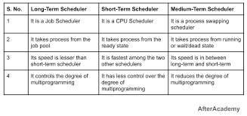

Slide 19
Scheduling Algorithms:
1. First-Come, First-Served (FCFS) Scheduling-
2. Shortest-Job-First (SJF) Scheduling-
3. Priority Scheduling-
4. Shortest Remaining Time Next(SRTN)-
5. Round Robin(RR) Scheduling-
6. Multiple-Level Queues Scheduling-

Slide 20
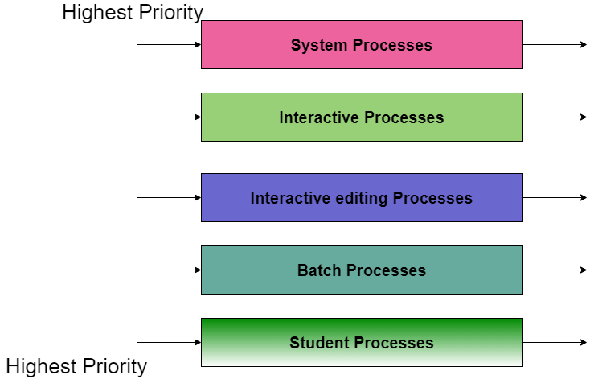
6)Multilevel Queue Scheduling Algorithm:
A multi-level queue scheduling algorithm partitions the ready queue into several separate queues. The processes are permanently assigned to one queue, generally based on some property of the process, such as memory size, process priority, or process type. Each queue has its own scheduling algorithm.
multilevel queue-scheduling algorithm with five queues:
1)System Processes-
2)Interactive Processes-
3)Interactive Editing Processes-
4)Batch Processes-
5)Student Processes-

Slide 21
Multilevel Queue Scheduling Algorithm:
The Description of the processes in the above diagram is as follows:
System Process-Â The Operating system itself has its own process to run and is termed as System Process.
Interactive Process-Â The Interactive Process is a process in which there should be the same kind of interactionÂ (basically an online game ).
Batch Processes-Â Batch processing is basically a technique in the Operating system that collects the programs and data together in the form of theÂ batchÂ before theÂ processingÂ starts.
Student Process-Â The system process always gets the highest priority while the student processes always get the lowest priority.In an operating system, there are many processes

Slide 22
Threads:
Threads
In a single processor system a process is a program that performs a single thread of execution.
• Example: When a process is running a word-processor program, a single thread of instructions is being executed.
• This single thread of control allows the process to perform only one task at a time.
• The user cannot simultaneously type in characters and run the spell checker within the same process.
In multicore system or multi-processor system allows a process to run multiple threads of execution in parallel. On a system that supports threads, the PCB is expanded to include information for each thread
A thread is a path of execution within a process. A process can contain multiple threads.

Slide 23
Types of Threads
There are two types of threads.
User Level Thread
User Level Thread:
Kernel Level Thread:
-Is implemented in the user level library, they are not created using the system calls. Thread switching does not need to call OS and to cause interrupt to Kernel. Kernel doesn’t know about the user level thread and manages them as if they were single-threaded processes.
Advantages of ULT –
Can be implemented on an OS that doesn’t support multithreading.
Simple representation since thread has only program counter, register set, stack space.
Simple to create since no intervention of kernel.
Thread switching is fast since no OS calls need to be made.
Types of Threads
There are two types of threads.
User Level Thread
Kernel Level Thread

Slide 24
Kernel Level Thread (KLT) – Kernel knows and manages the threads. Instead of thread table in each process, the kernel itself has thread table (a master one) that keeps track of all the threads in the system. In addition kernel also maintains the traditional process table to keep track of the processes. OS kernel provides system call to create and manage threads.
Advantages of KLT –
Since kernel has full knowledge about the threads in the system, scheduler may decide to give more time to processes having large number of threads.
Good for applications that frequently block.
Limitations of KLT –
Slow and inefficient.
It requires thread control block so it is an overhead.

Slide 25
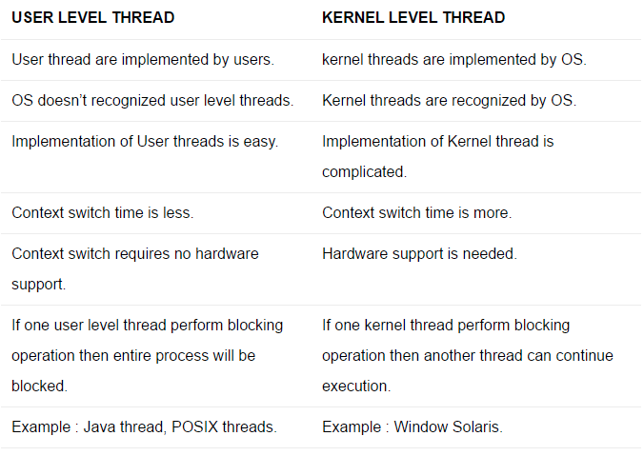

Slide 26
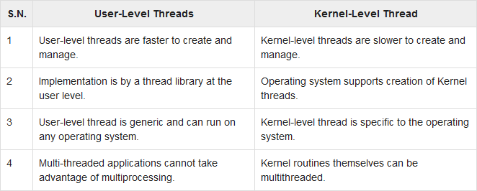

Slide 27
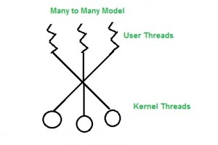
Multi Threading Models in Process Management:/Multithreading Models:
Multi threading-It is a process of multiple threads executes at same time.
Multi threading model are of three types:
Many to many model.
Many to one model.
one to one model.
: Many To Many Model:It is the best multi threading model.
In this model, we have multiple user threads multiplex to same or lesser number of kernel level threads. Number of kernel level threads are specific to the machine, advantage of this model is if a user thread is blocked we can schedule others user thread to other kernel thread. Thus, System doesn’t block if a particular thread is blocked.

Slide 28
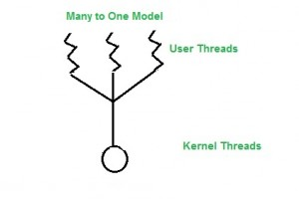
2)Many to One Model:
In this model, we have multiple user threads mapped to one kernel thread. In this model when a user thread makes a blocking system call entire process blocks. As we have only one kernel thread and only one user thread can access kernel at a time, so multiple threads are not able access multiprocessor at the same time.
The thread management is done on the user level so it is more efficient.

Slide 29
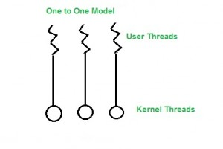
3)One to One Model -
In this model, one to one relationship between kernel and user thread. In this model multiple thread can run on multiple processor. Problem with this model is that creating a user thread requires the corresponding kernel thread.
As each user thread is connected to different kernel , if any user thread makes a blocking system call, the other user threads won’t be blocked.

Slide 30
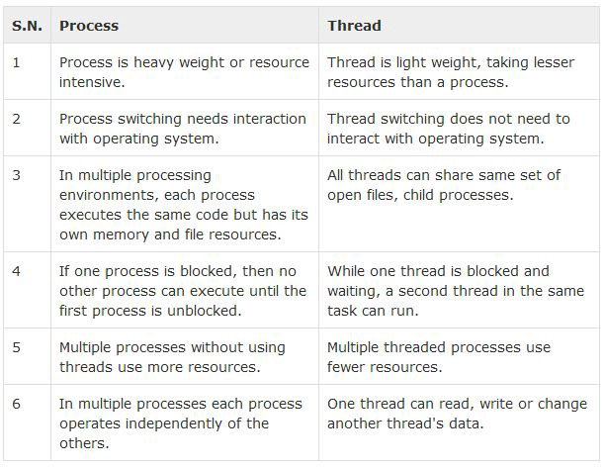

Slide 31
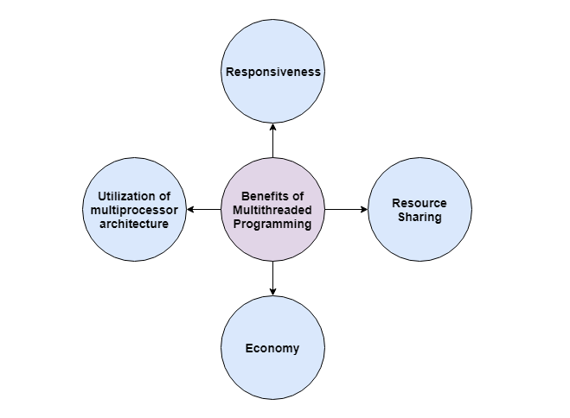
Multithreading allows the execution of multiple parts of a program at the same time. These parts are known as threads and are lightweight processes available within the process. So multithreading leads to maximum utilization of the CPU by multitasking.

Slide 32
Resource Sharing
All the threads of a process share its resources such as memory, data, files etc. A single application can have different threads within the same address space using resource sharing.
Responsiveness
Program responsiveness allows a program to run even if part of it is blocked using multithreading. This can also be done if the process is performing a lengthy operation. For example - A web browser with multithreading can use one thread for user contact and another for image loading at the same time.
Utilization of Multiprocessor Architecture
In a multiprocessor architecture, each thread can run on a different processor in parallel using multithreading. This increases concurrency of the system. This is in direct contrast to a single processor system, where only one process or thread can run on a processor at a time.
Economy
It is more economical to use threads as they share the process resources. Comparatively, it is more expensive and time-consuming to create processes as they require more memory and resources. The overhead for process creation and management is much higher than thread creation and management.

